Slide 1




Film & TV Demographic Analysis
Capstone Project 2

Slide 2
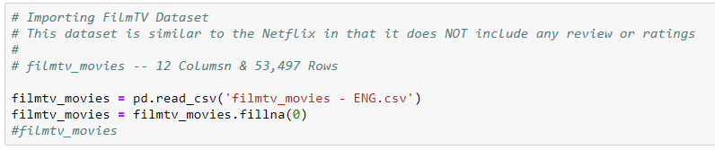
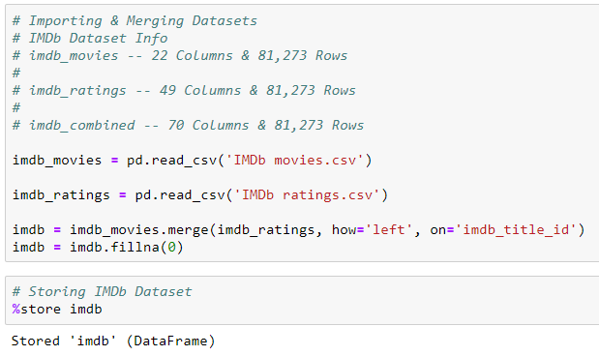
Importing Data
1
1. Gathering FilmTV Dataset
2
2. Gathering, merging and storing IMDb Dataset

Slide 3
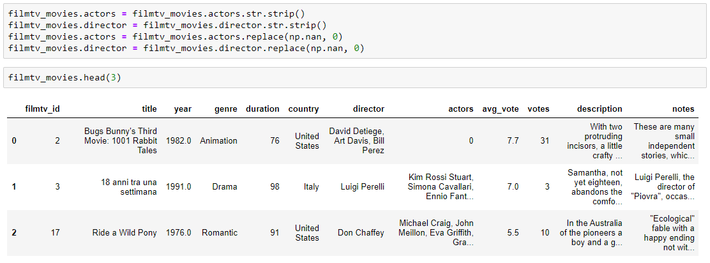
Slide 3
3
Cleaning actors and directors columns to be used later to extract top 50 from each column.

Slide 4
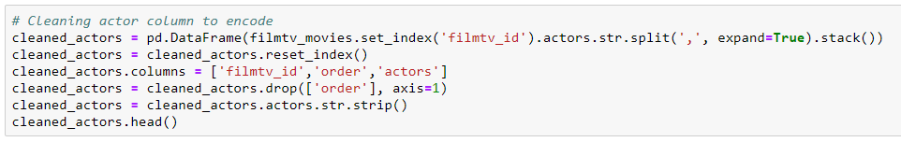
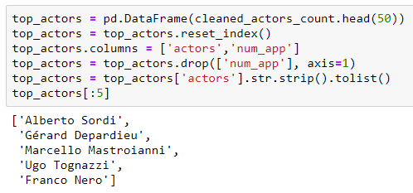
Slide 3
4
4. Cleaning actors column to be used later to extract top 50 from each column.
5. Extracting the top 50 actors which will be used to create a matrix for transformation into columns indicating is a top actor is found in that film.
5

Slide 5
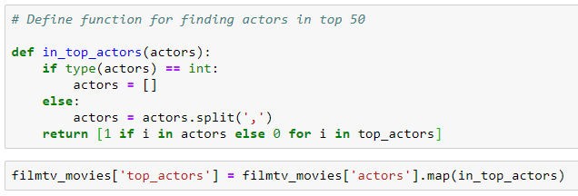
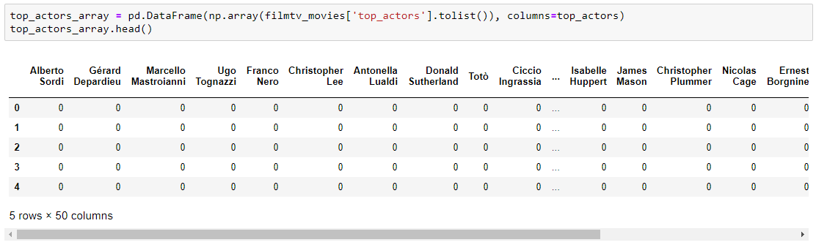
Slide 3
6
6. Defining a function to find the top actors in each movie row, then mapping that to a new column.
7. Converting the matrix column into individual column headers. This was done for actors, directors, genre and country
7

Slide 6

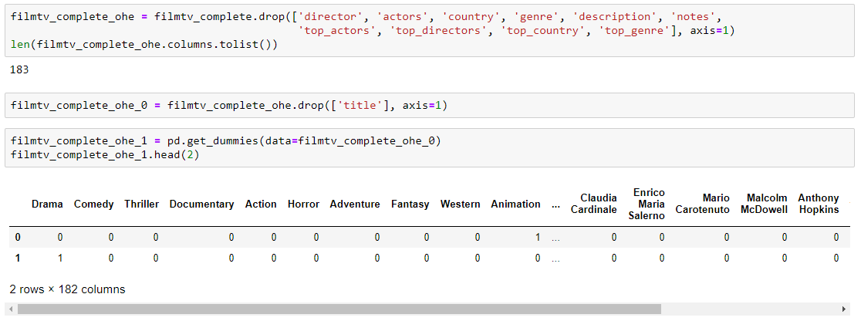
Slide 3
8
8. I then concatenated all of the top 50 columns together
9. I dropped all of the non essential columns and created dummy variables to get my final dataframe to be used in my model.
9

Slide 7


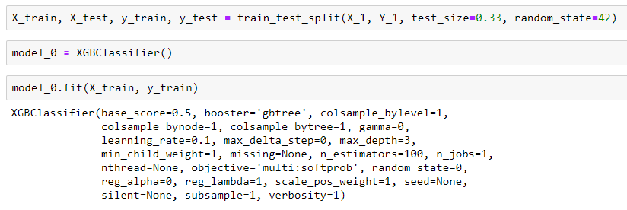
Slide 3
10
10. Next I separated my data into my independent and dependent variables to be used in the train test split. Finally I fit my model to my dataset

Slide 8
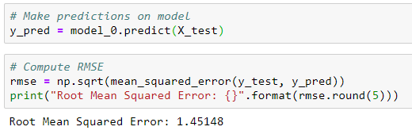
Slide 3
11
11. Once my model had been fit I used the predict method so that I could test to see how my model performed. I chose to use the Root Mean Squared Error as my test metric.

Slide 9
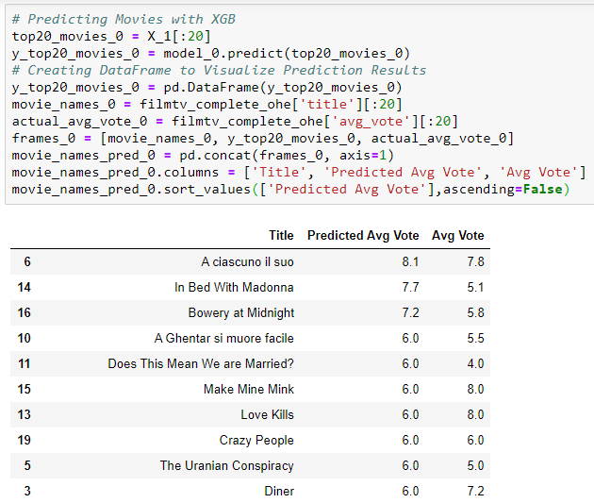
Slide 3
12. To visualize my models predictions I took the top 20 movies from my dataset, predicted the average vote, then created a new dataframe to compare the predicted values to the actual values
12

Slide 10
IMDb Dataset
For the IMDb dataset I choose to test different variables against my list of features. This dataset included average votes broken into demographics such as age and sex. So I chose to use females age 30 as my test variable, then look into what were the most important features for that demographic.

Slide 11


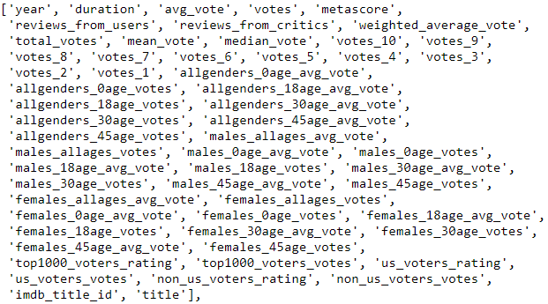
Importing Data
1
1. Importing my cleaned IMDb datasets. From here I only want to grab a couple of columns; the metascore and the females_30age_avg_vote

Slide 12

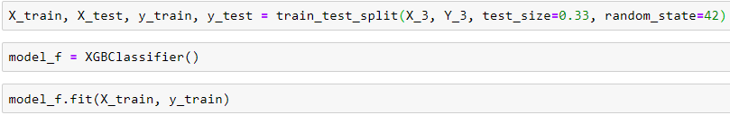
Slide 3
2
2. Next I concatenate my target variable with my features, then divide them up for the train test split function.
3. Once I have my data split I fit it to my model.
3

Slide 13
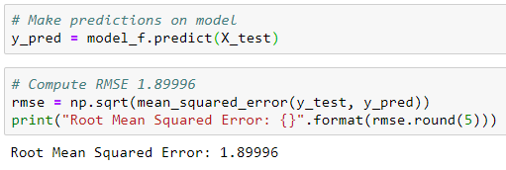
Slide 3
4
4. Next I make predictions on my model in order to test it accuracy. After running the Root Mean Squared Error test I end up with a value of 1.89996, which isn’t as good of a value as I had hoped for, considering that the votes are on a scale of 1 to 10

Slide 14

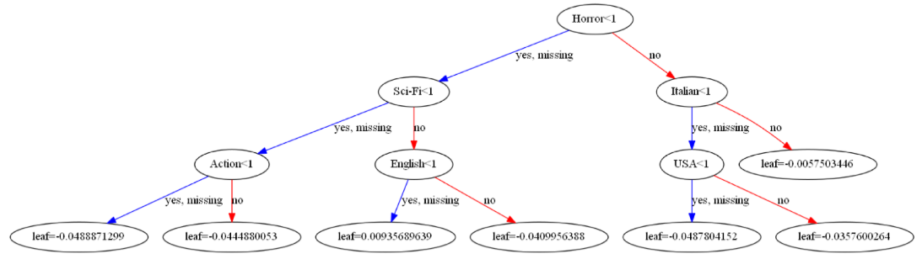
Slide 3
5
5. Here we get a visualization of the a section of the decision tree made throughout the models progression.

Slide 15
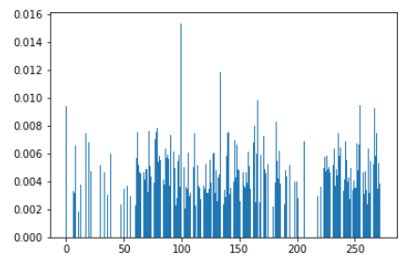

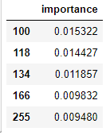
Slide 3
6
7
6. The most important visualization I wanted to get across was the feature importance, represented about by the bar graph.
7. Next I needed to dig into which features held the most importance. This is shown in the dataframe to the right. The features are listed by their index value and are as follows; Crime, UK, Denmark, Javed Akhtar, and Millennium Films

Slide 16
Research Presentation End
Notes:
You can use this slide as your opening or closing slide. Should you choose to use it as a closing, make sure you review the main points of your presentation. One creative way to do that is by adding animations to the various graphics on a slide. This slide has 4 different graphics, and, when you view the slideshow, you will see that you can click to reveal the next graphic. Similarly, as you review the main topics in your presentation, you may want each point to show up when you are addressing that topic.
Add animation to images and graphics:
Select your image or graphic.
Click on the Animations tab.
Choose from the options. The animation for this slide is “Split”. The drop-down menu in the Animation section gives even more animations you can use.
If you have multiple graphics or images, you will see a number appear next to it that notes the order of the animations.
Note: You will want to choose the animations carefully. You do not want to make your audience dizzy from your presentation.

